Slide 1


Plan Perfect
PLAN
PERFECT
IT320 PROJECT

Slide 2


OUR AGENDA
1
Introduction
6
Use Case Diagrams
2
Problem Statement
7
System Architechtures
3
Proposed Solution
8
Overview of testing results
4
Functional Requirements
5
Non-functional Requirements

Slide 3

INTRODUCTION
The event planning industry is rapidly growing worldwide, Despite its growth, the industry remains fragmented and inefficient.
Individuals and organizations often struggle to find trusted service providers (venues, caterers, photographers)
Traditional methods like word-of-mouth and random online searches cause:
Delays in decision-making
Miscommunication
Budget mismanagement
These inefficiencies highlight the need for digital transformation in event planning.

Slide 4

Fragmented Vendor Market
Individuals and organizations struggle to find reliable event service providers (e.g., venues, caterers, photographers). The absence of a unified platform leads to inefficient vendor discovery
Manual and Unstructured Planning
Event organizers often rely on word-of-mouth or scattered online searches. This outdated approach results in delays, vendor overbooking, and poor budget control.
PROBLEM STATEMENT
Stressful and Time-Consuming Process
Without a streamlined system, event planning becomes overwhelming—full of miscommunications, pricing confusion, and last-minute changes.

Slide 5




OUR PROPOSED SOLUTIONS
Centralized Vendor Discovery
Smart Booking & Financial Tools
User-Friendly Planning Interface
PlanPerfect brings all essential service providers (venues, caterers, decorators, and more) into one platform. This eliminates the need for scattered online searches and unreliable sources.
Users can browse services, compare prices and book vendors directly all in one place. This ensures transparency, budget control, and smoother planning.
An intuitive dashboard guides users through the entire planning journey, reducing stress and miscommunication. The platform ensures a seamless and accessible experience for all users.

Slide 6
REQUIREMENTS
User Registration (incl. verification & email check) | Password Rules
User Login (incl. incorrect credentials, reset, redirect) | Session Termination (Logout)
User Logout (incl. access restriction post-logout) | Immediate DB Save (Vendor Services)
Vendor Service Management (add, edit, delete, confirm) | Immediate Removal from Listings
Real-Time Updates (Vendor Service Edit) | Add to favourite

Slide 7
REQUIREMENTS
Vendor Search (incl. location, price, and rating filters) | Vendor Profile Viewing (incl. service details and accessibility)
Vendor Rating & Review (incl. star rating, review, vendor response) | User Profile (incl. preferences, budget, event type updates)
Booking System (incl. vendor selection, availability check, confirmation) | Date Selection (incl. required date input and availability check)
Service Cancellation (incl. dashboard access and vendor notification) | Performance Optimization (incl. <3s page and search load time)
High Availability (incl. 99.9% uptime, auto-scaling, load balancing) | High Availability (incl. 99.9% uptime, auto-scaling, load balancing)

Slide 8
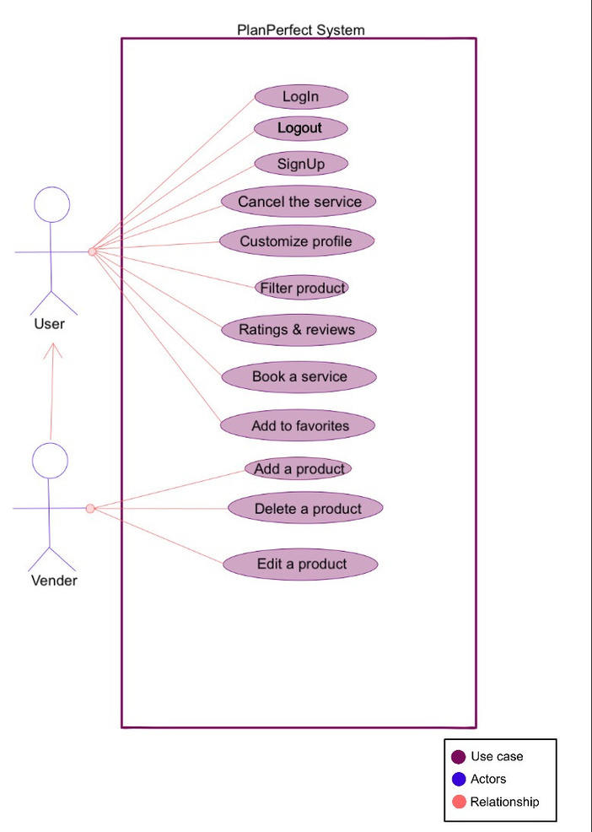
Use Case Diagram
TWO MAIN ROLES: USER AND VENDOR
• Users can register, search, book, and review services.
• Vendors can also manage services and view bookings.
• All actions are direct – no includes or extends.

Slide 9
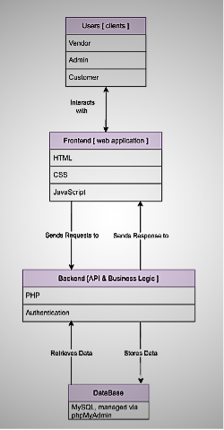
System Architecture
FOLLOWS A CLIENT-SERVER ARCHITECTURE
• Frontend: HTML, CSS, JavaScript – for user interface.
• Backend: PHP – handles business logic.
• Database: MySQL – stores all data.

Slide 10
OVERVIEW OF TESTING RESULTS
Our testing process was divided into three phases:
1. User Story Acceptance Testing
2. Integration Testing
3. User Acceptance Testing (UAT)

Slide 11
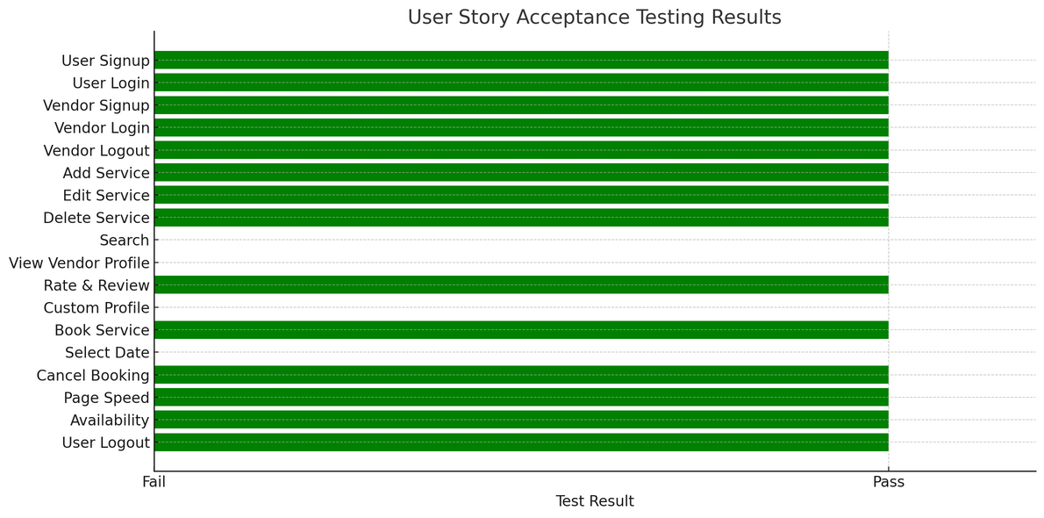
OVERVIEW OF TESTING RESULTS
1. User Story Acceptance Testing
We evaluated each feature against its user story to ensure it met the acceptance criteria.
Most core features passed, including sign-up, login, logout, adding/editing/deleting services, and booking/canceling.
Some features failed, such as:
Vendor profile viewing (not available to users).
Custom profile preferences and smart recommendations (not implemented).
Service search only works by price, not location.
Most user needs were satisfied, but enhancements are needed for search and personalization.

Slide 12
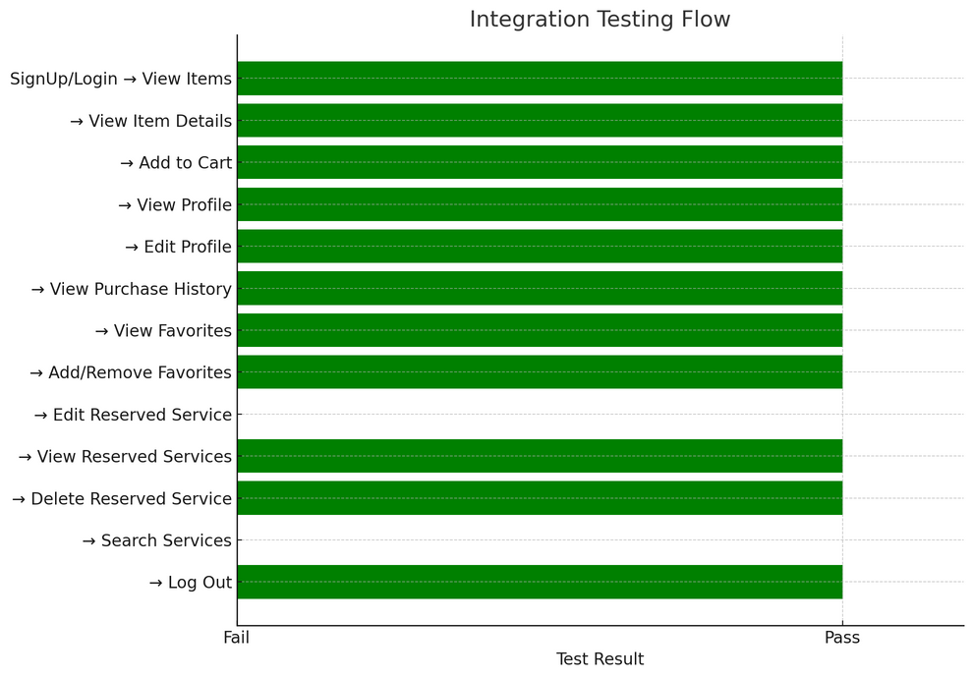
OVERVIEW OF TESTING RESULTS
2. Integration Testing
We verified that system components work together seamlessly.
Components like viewing items, adding to cart, editing profile, and viewing history all passed.
A few features (like editing reserved service or search) had issues due to missing or incomplete connections.
Integration across most modules succeeded, with minor issues needing attention in future sprints.

Slide 13
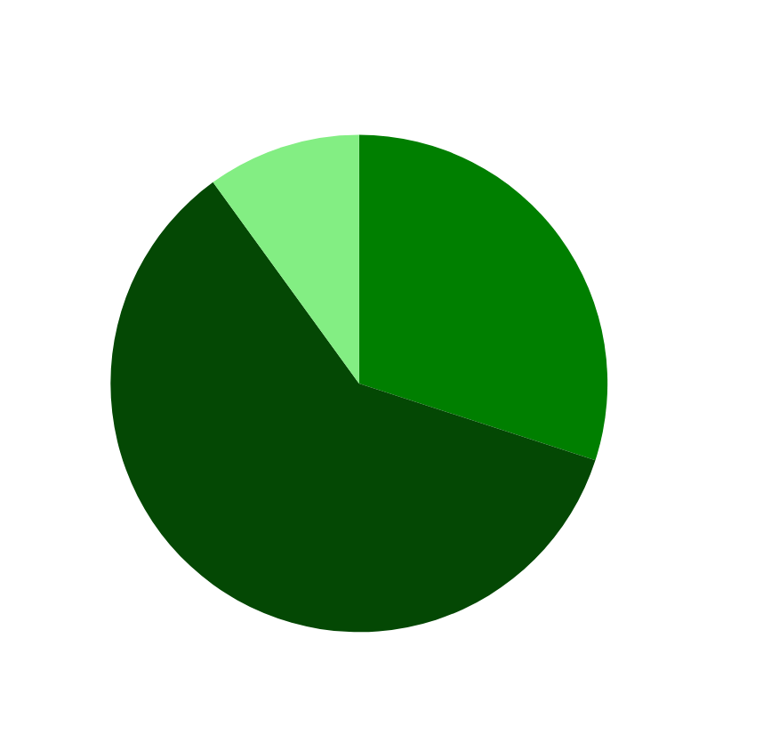
OVERVIEW OF TESTING RESULTS
3. User Acceptance Testing (UAT)
We tested with 10 users from our target demographic.
Successes:
Easy registration and login (100%)
Fast page load (< 3 seconds)
Reliable uptime (99.9%)
Booking and cancellation worked as expected
Gaps Identified:
Vendor profile viewing missing
Vendor search and filter not fully functional
No custom profile settings or smart recommendations
Core tasks were completed successfully, but some expected features were not yet available.

Slide 14
THANK YOU
for your time and attention
Presented by PlanPerfect Team

